Slide 1

Fundamentals of Politics Research Lecture 10 (2020-21) Concepts Dr Adrian Blau

Slide 2
Today
1. Studying politics at university | 7. Facts and values
2. Questions | 8. Him and hers
3. Answers | 9. Subject and object
4. A science of politics? | 10. Concepts
5. Quantitative and qualitative | 11. Bullshit
6. Reading week | 12. Recap: ethical scholarship
asdasdasd
Recap
What we do
How we think
How we do it

Slide 3
Concepts: why focus on them?
Everyone uses concepts.
Most people don’t use them well – which can hinder research.
Using them well can help you.
helps you assess what is good and bad;
helps you improve what was written;
helps you think and write clearly;
can improve structure.

Slide 4
Today
Not defining concepts.
Not defining concepts well.
The concept/conception distinction.
Examples of better definitions.
Exercise, based on the old exam and seminar.
More tips, a great example.
Two common errors.
Essentially contested concepts, vagueness.

Slide 5
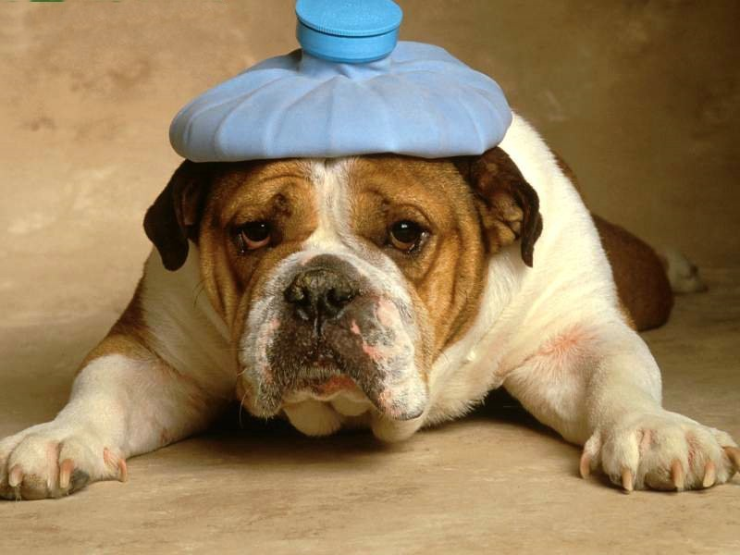
Warning

Slide 6
Not defining concepts at all
Tuck (2004): is Hobbes ‘utopian’?
Foley (1993): a British ‘presidency’.
Lots of people: is first-past-the-post ‘fair’?
(See Blau 2004.)
These are all evaluations – part conceptual, part empirical.

Slide 7

Not defining concepts well
Richards and Smith’s (2002, 15) ‘formal definition’:
‘ “Governance” is a descriptive label that is used to highlight the changing nature of the policy process in recent decades. In particular, it sensitizes us to the ever-increasing variety of terrains and actors involved in the making of public policy. Thus, it demands that we consider all the actors and locations beyond the “core executive” involved in the policy-making process.’

Slide 8
Isaiah Berlin (1969)
Negative liberty “is involved in the answer to the question ‘What is the area within which the subject is or should be left to do or be what he is able to do or be, without interference by other persons?’ ”.
Pos lib “is involved in the answer to the question ‘What, or who, is the source of control … that can determine someone to do, or be, this rather than that?’ ”.
This fools some scholars (e.g. Goldsmith 1989, 31-2).
➢ Tip: don’t start by presenting an idea as the answer to a question.

Slide 9
Berlin’s woes continue
Positive liberty ‘derives from the wish on the part of the individual to be his own master’ (Berlin 1969, 131).
Taylor (1991, 141): positive liberty ‘resides … in collective control over the common life’ (1991, 141).
➢ Tip: define concepts directly, not indirectly.

Slide 10
Berlin is not completely useless
Treats negative liberty as a matter of degree (‘scalar’).
➢ Tip: ask if your concept is scalar. How many scales?
Contrasts negative liberty with ability.
Contrasts mere unfreedom and coercion (1969, 122-3).
Contrasts his and Mill’s notions of negative freedom (1969, 139-40).
➢ Tip: after defining a term, it can help to contrast it with similar ideas, or (as with unfreedom vs. coercion) distinguish different versions of the same idea.

Slide 11
Concepts and conceptions
A concept is a general idea, a conception is a particular version of that concept (Rawls 1971, 5; §1).
Corruption ➔ moral corruption, political corruption, etc.
Political corruption ➔ bribery, nepotism, theft, grand, petty, etc.

Slide 12
Examples 1 and 2
MacCallum (1967): Agent X is free if not stopped by constraint Y from doing action Z.
Darwall (2002, 1): welfare is ‘the good of a person in the sense of what benefits her. This differs … from what a person herself values, prefers, or takes an interest in’.
Welfare is what is objectively good for a person, which may or may not be the same as what is subjectively good for the person.

Slide 13
Example 3
Tsebelis (2002, 2): ‘In order to change policies … a certain number of individual or collective actors have to agree to the proposed change. I call such actors veto players. Veto players are specified in a country by the constitution … or by the political system …. I call these two different types of veto players institutional and partisan veto players, respectively.’

Slide 14
Example 4
Lijphart (1996, 258): consociationalism is ‘characterized by (1) grand coalition governments that include representatives of all major linguistic and religious groups, (2) cultural autonomy for these groups, (3) proportionality in political representation and civil service appointments, and (4) a minority veto with regard to vital minority rights and autonomy.’

Slide 15
Exercise
Define one or both of the following terms, distinguishing if needs be between different conceptions of your concept, and/or between different concepts:
terrorism
sport

Slide 16
Tips
➢ Tip: Be careful of dictionaries & etymology, and using just one definition: compare.
1. Read existing scholarly definitions/accounts.
2. Use/amend existing definition, or create one.
3. Distinguish it from other ideas if needs be.
4. Check the definition.
5. Throw different examples at the definition; go back to step 2 if needs be.
An iterative process.

Slide 17
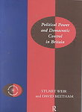
Example: Weir and Beetham
Democracy ➔ political equality and popular control
➔ authorisation, accountability, responsiveness, representativeness
➔ 30 questions, e.g. ‘How far is there systematic opportunity for citizens to vote directly on basic constitutional changes?’
Attempt to answer those questions empirically.
On KEATS. See also Lord and Beetham (1998).

Slide 18
Two common conceptual errors: 1
False dichotomy (A or B).
How to escape a false dichotomy:
It’s not A or B, it’s A and B.
i.e. the choice is not exclusive.
It’s not A or B, it’s C.
i.e. the choice is not exhaustive.
It’s not A or B, it’s a matter of degree between A and B.
… several scales … between A and C … etc.

Slide 19
Two common conceptual errors: 2
Over-generalisation.
‘Turnout is falling because people distrust politicians.’
Esarey and Chirillo (2013), repeatedly, e.g. ‘women are more averse to risk-taking than men when facing comparable incentives’, ‘women are less tolerant of corruption than men in Australia’ (pp. 362, 364).

Slide 20

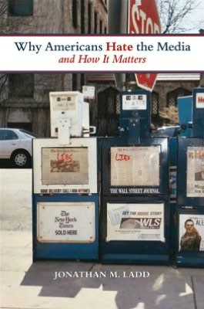

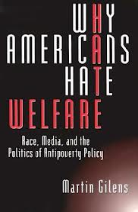
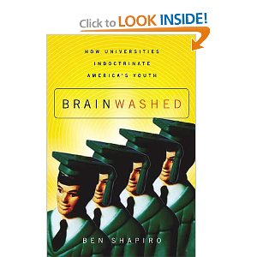



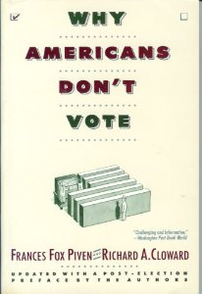

Slide 21
Essentially contested concepts
Gallie (1956).
There is something unclear in the core (essence) of a concept, therefore it is inevitable (essential) that there will be disagreement.
Democracy: popular control and political equality.
Often normative.

Slide 22
Vagueness
Sorensen (2006): ‘a term is vague to the extent that it has borderline cases. … If you cut one head off of a two headed man, have you decapitated him? What is the maximum height of a short man?’
We can stipulate that ‘decapitate’ means remove one head, or that short men are under 5 foot 8/1.73 m (in the UK in the 21st century), for example.
But stipulation is merely a practical solution.
Vagueness is not ambiguity (having more than one meaning). Words can be ambiguous and/or vague.

Slide 23
Conclusion
Most political terms are essentially contested. Politics is sometimes about the ‘right’ decontestation.
We should avoid common conceptual errors.
Many academics don’t define key terms, or try and fail.
Good definition is iterative. It takes practice, lots of trial and (especially) error, and often headaches. But it’s worth it in the end.

Slide 24
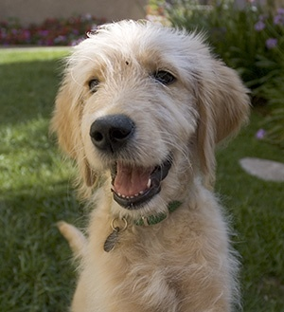
Conceptual clarity: because it’s worth it.

